Slide 1
An Lp theory for outer measures. Application to singular integrals.
Christoph Thiele
Santander, September 2014

Slide 2
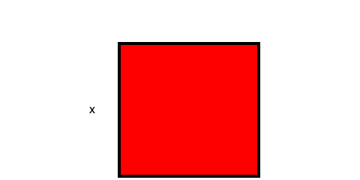
Squares
Area (2-volume) of a square E of sidelength x

Slide 3
Properties of area of square
Can be written down explicitly in terms of sidelength.
Is invariant under translation
Has a certain scaling behaviour under dilation, respecting dimensionality

Slide 4
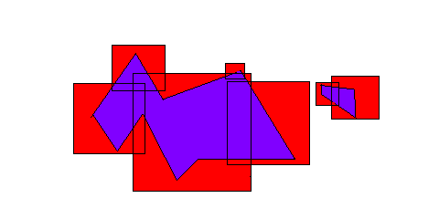
Lebesgue outer measure of set
For an arbitrary subset of the plane, define the outer measure using at most countable coverings by squares

Slide 5
Concrete versus abstract
Specified a concrete generating function on a small collection of sets (here: squares)
Defined outer measure abstractly by using countable coverings by these concrete sets

Slide 6
Coincidence of sigma and mu
For squares E , sigma and mu coincide
Establishing this is one of the more tedious parts of the standard introduction of Lebesgue measure. Uses compactness arguments.
Such identity need not hold for other outer measures.

Slide 7
Outer measure
Subadditive set function on all subsets of a set X
1) homogeneous
2) monotonicity
3) Countable sub-additivity

Slide 8
From sub-additivity to additivity
Typically we have for subadditivity for disjoint sets, e.g.
A set E is called Caratheodory measurable (“good pair of scissors”) if for all sets S (suffices to test for S a generating set)
All susets of the plane have an outer measure, but only some are measurable.

Slide 9
Caratheodory measurability
For countable collections of pairwise disjoint Caratheodory sets we have additivity:
Important in integration theory, as it relates to
Linearity of integral

Slide 10
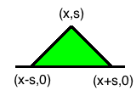
Tents (or Carleson boxes)
X is the open upper half plane, generating sets are tents T(x,s) :
All tents stand on the real axis. Tents form a much more restricted collection than dyadic cubes. Dfeine outer measure on X by

Slide 11
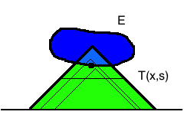
No nontrivial Caratheodory sets
E in upper half plane with nonempty boundary,
T(x,s) tent which contains a boundary point of E
above half of its height:

Slide 12
Integration theory
Try to generalize measure to functions (which can be viewed as “weighted” sets.
Identifying measurable set E with the characteristic function
An integration theory for outer measures will not be linear. Theory of norms rather than integral.

Slide 13
Classical Choquet integral
If f is a function on outer measure space, may define
We will generalize this definition, following a
Concrete-to-abstract principle as in the
definition of outer measure.

Slide 14
Concrete average, size
Will play for norms of functions the same role as the assignment for the definition of outer measure. In case of Lebesgue measure for a given nonnegative function f and a dyadic cube Q
In caes of Lebesgue: The size contains enough information to reproduce f, it is a more efficient code than pointwise a.e information. It is redundant information, a countable collection of squares suffices.

Slide 15
Examples of sizes
Ex 1) Lebesgue outer measure of dyadic cube Q
Ex 2) Upper half space / tents as generating sets
In Ex 1) the size closely resembles the (L1) outer norms
To be defined, in Ex 2) it will be rather different

Slide 16
General Size
Assume X metric space. A size is a function on Borel functions on X and generating sets
Homogeneity
Monotonicity
Subadditivity
These mirror properties of outer measure. 2) implies S(f)= S(|f|). Sometimes one uses quasi-subadditivity in lieu of 3)

Slide 17
Outer essential supremum
Space of functions with finite out.ess.supremum
Coincides with classical Linfty space in case of Lebesgue outer measure.

Slide 18
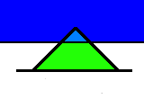
Outer ess sup not equal ess sup
In this case outer Linfty functions are called Carleson measures

Slide 19
Special sizes
If we define the size
With classical essup in Borel sense on each tent,
Then outsup and classical essup coincide on the whole space X. Most existing theories of outer measure (capacity theory) seem to be subsumed into new theory in this manner.

Slide 20
Outer supremum on subset
Define outer supremum on a Borel set F
F enters as modifying f, but not impacting the testing sets E. In Lebesgue case this gives same as classical.

Slide 21
Outer Lp spaces
Define super level measures
Define Lp norms
Also weak Lp (Lorentz space)

Slide 22
Basic properties of outer Lp
Sums: (Quasi) triangle inequality
Products: (Quasi) Hölder inequality for three sizes with

Slide 23
Further properties of outer Lp
Log convexity in p
Marcinkiewicz interpolation for operators mapping into outer Lp spaces
Transformation laws under mappings of X
Outer triangle inequality for linear functional:
If for all generating sets E
Then

Slide 24
Embedding maps
What is the upper half plane for?
Natural representation of functions on real line.
For fixed (e.g. Schwartz) function ϕ define a map from functions f on the real line to functions F in the upper half space

Slide 25
Examples
Examples for ϕ:
Poisson kernel, then this is harmonic extension (heart of harmonic analysis), or
derivative of Poisson kernel, gives conjugate harmonic function
heat kernel, gives heat extension
discrete variants such as Haar, wavelets

Slide 26
Embedding theorems
Thm: Define for fixed Schwartz function ϕ
Then we have:
If φ has integral zero:

